Slide 1

Rockbuster Stealth Data Analysis Project

Slide 2
Goal
Answer business questions to help Rockbuster company create its 2020 strategy plan

Slide 3
Business Questions
Which movies contributed the most/least to revenue gain?
What was the average rental duration for all videos?
Which countries are Rockbuster customers based in?
Where are customers with a high lifetime value based?
Do sales figures vary between geographic regions?

Slide 4

At First Glance
2 Stores
1000 Movies
20 Categories
16044 Rentals
599 Customers
109 Countries
61312 $ Revenue

Slide 5
Rental Movie Summary
Rental Rate
Maximum
4,99
Minimum
0,99
Average
2,98
Rental Duration
Maximum
7 day
Minimum
3 days
Average
5 days
Length
Maximum
185 min
Minimum
46 min
Average
115 min
Replacement Cost
Maximum
29,99 $
Minimum
9,99 $
Average
19,98 $

Slide 6
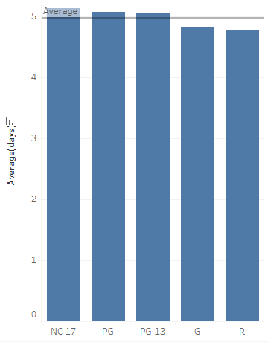
Average Rental Duration for All Videos by Rating
Although there is no significant difference, the rental duration by rating is as follows:
NC-17 (No Children Under 17 Admitted)
PG (Parental Guidance Suggested)
PG-13 (Parents Strongly Cautioned)
G (General Audiences)
R (Restricted)

Slide 7
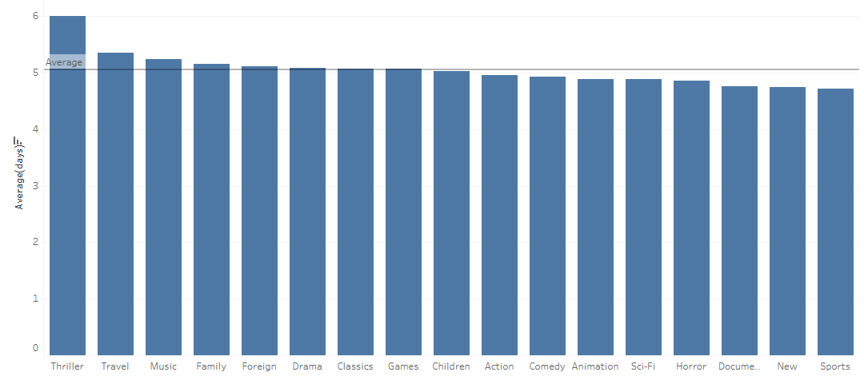
Average Rental Duration by Genre
Top 3 Categories rented for longer than average:
Thriller
Travel
Music
Categories rented with a duration less than average:
Documentary
News
Sports

Slide 8
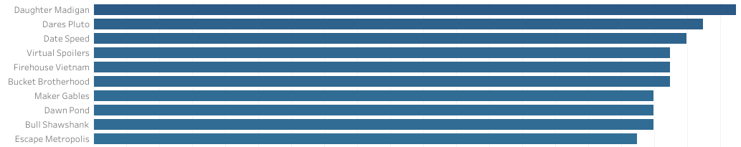
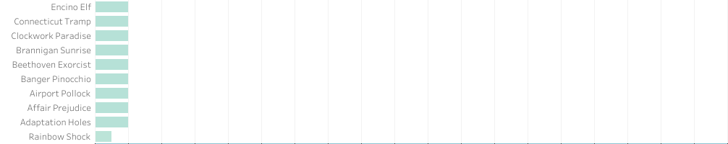
Most/least Movie Contribution to Revenue
AVERAGE
35,16 $
AVERAGE
1,88 $

Slide 9
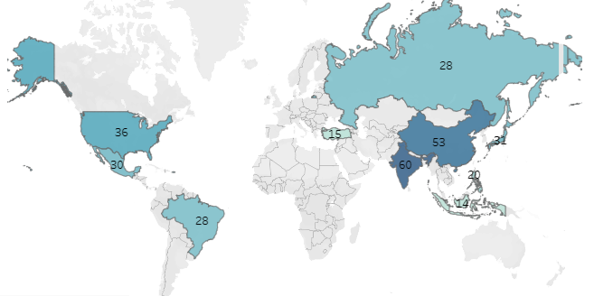
Customer Distribution in the World

Slide 10

Top 10 in the World
Top 10 COUNTRIES
India
China
United States
Japan
Mexico
Brazil
Russian Federation
Philippines
Turkey
Indonesia
Top 10 CITIES in the top 10 Countries
Aurora
Acua
Citrus Heights
Iwaki
Ambattur
Shanwei
So Leopoldo
Teboksary
Tianjin
Cianjur
Top 5 CUSTOMER in the top 10 cities | Total Amount Paid
Arlene Harvey | 111,76 $
Kyle Spurlock | 109,71 $
Marlene Welch | 106,77 $
Glen Talbert | 100,77 $
Clinton Aurora | 98,76 $

Slide 11
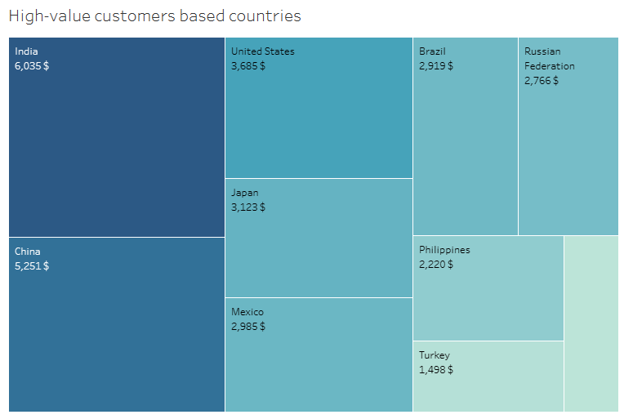
Variation of Sales Figures by Countries
Sales figures vary between geographic regions
The top 10 countries’ total revenue exceeds 30 000 $
India has the highest sales figures followed by China and the United States.

Slide 12
Insights
Films contributed the most, with an average of $35.16, and the least with an average of $1.88.
Movies are rented for an average of five days.
Countries with high lifetime value customers are also the countries with the highest number of customers.
The sales figures are not the same between the countries.

Slide 13

Diana Postica ms.diannn@gmail.com
Thank you

